Slide 1
Where to post my stories in reddit?
DSI12 - Project 3: Binary Classification
Shaun

Slide 2
Problem Statement
To help redditors to post their story in the most recommended subreddit

Slide 3
Steps
Collection of data
Cleaning of data
Data preparation / Feature engineering
Modelling
Model Selection
Findings
Recommendation

Slide 4
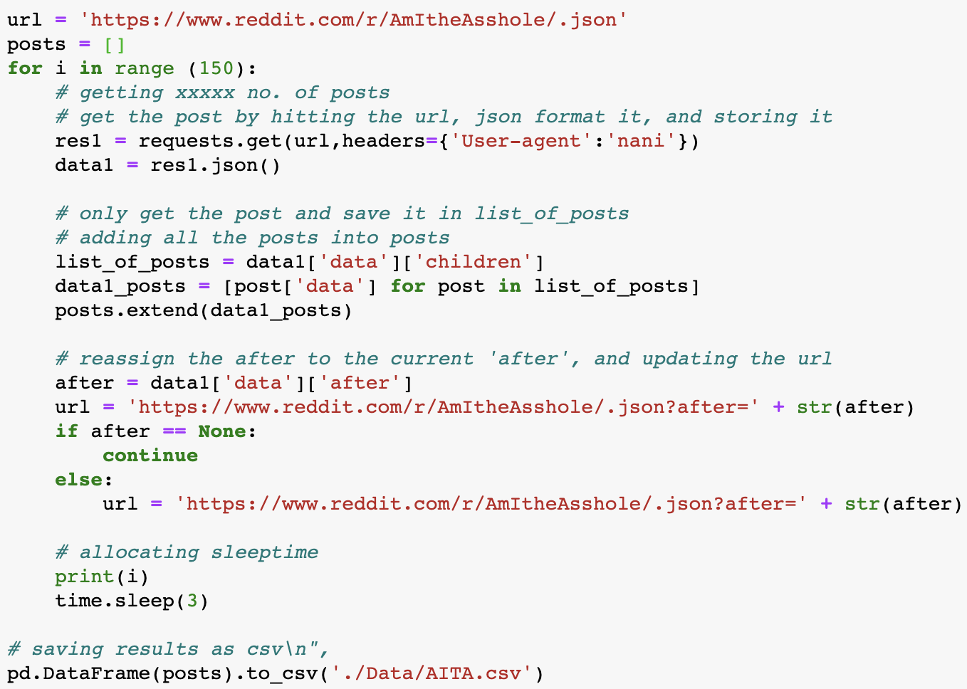
Collection of Data

Slide 5
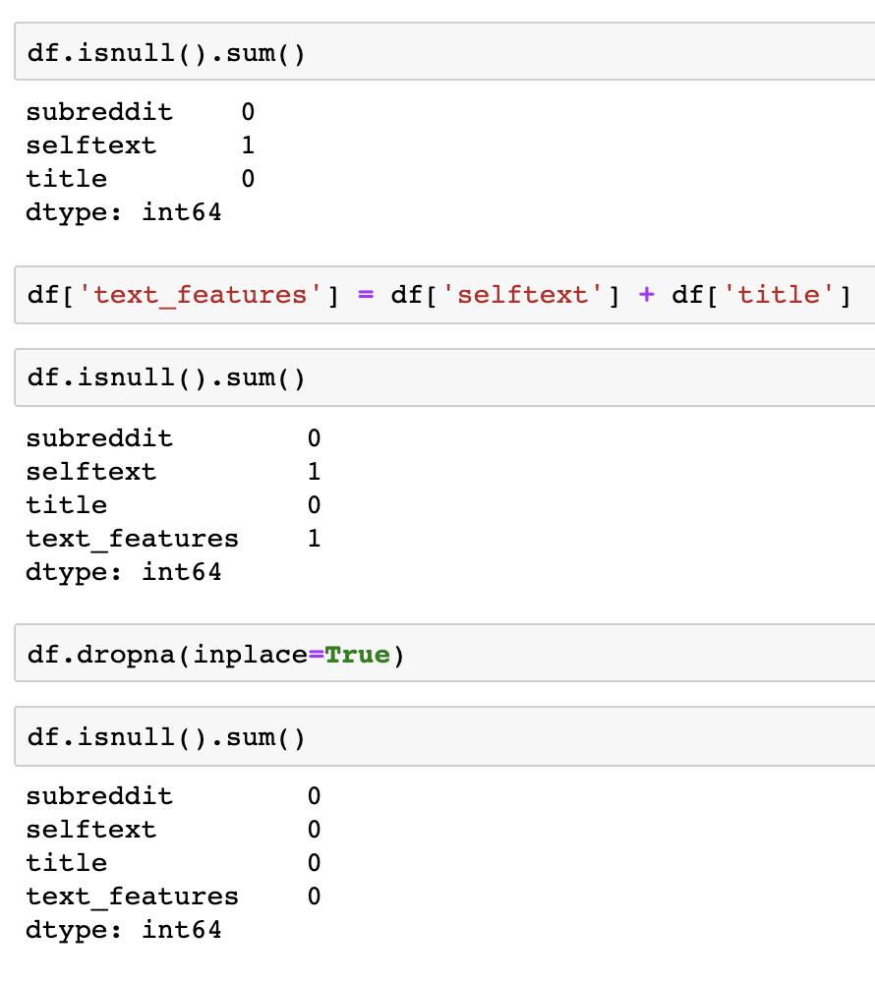
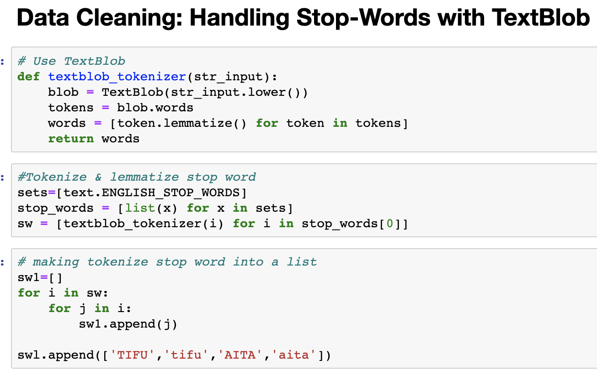
Cleaning of Data

Slide 6
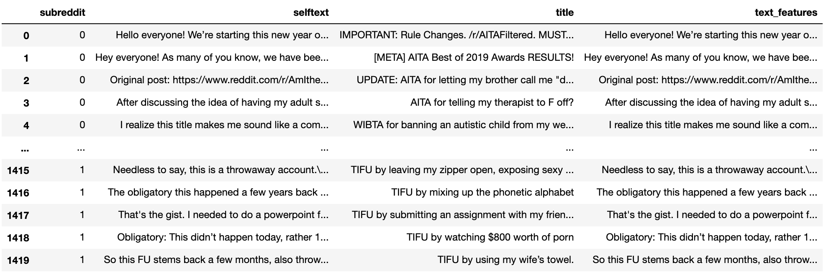
Data Preparation / Feature Engineering

Slide 7

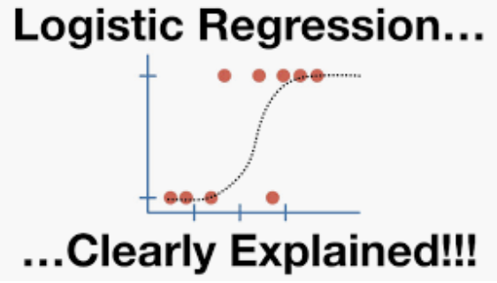

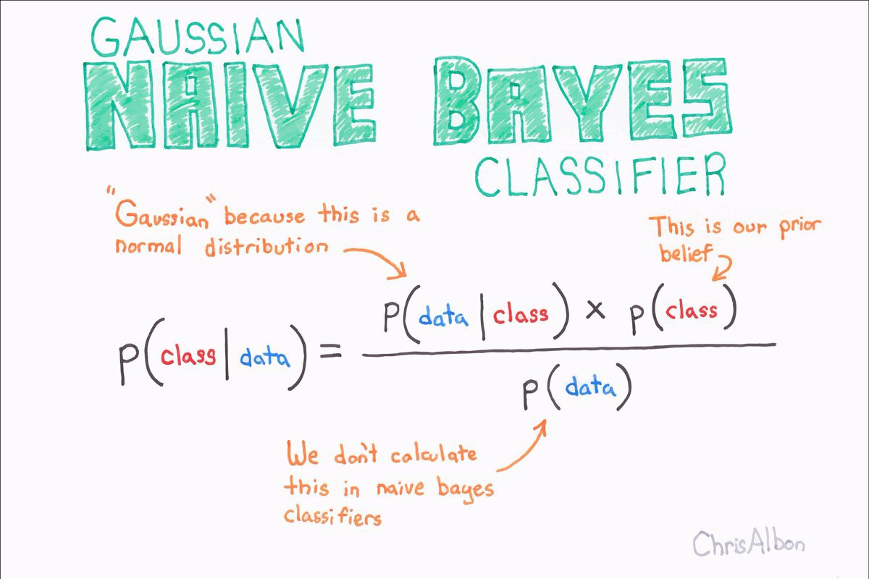
Modelling

Slide 8
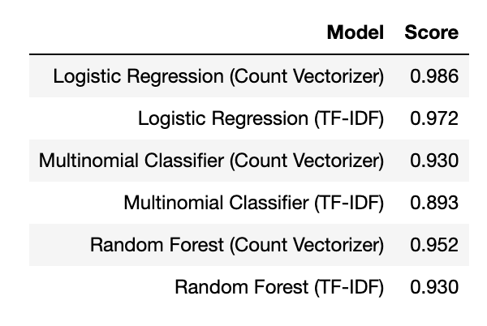
Model Selection

Slide 9
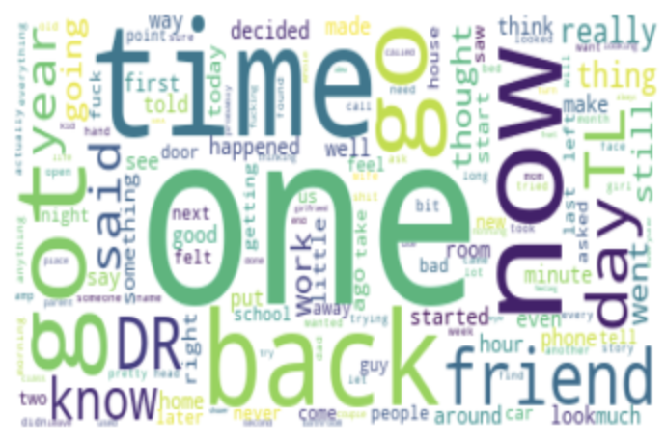
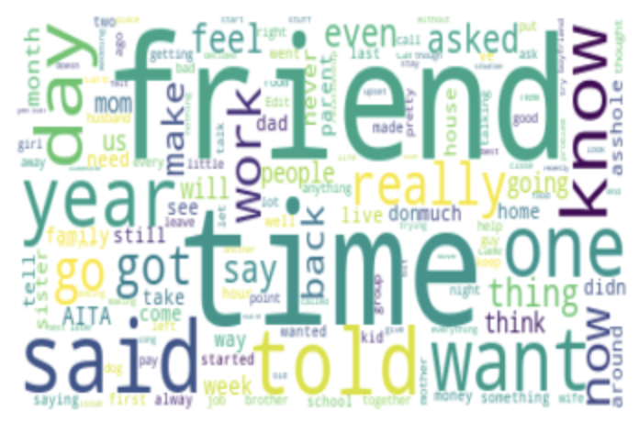
Initial Hypothesis & Findings
A.I.T.A
T.I.F.U

Slide 10
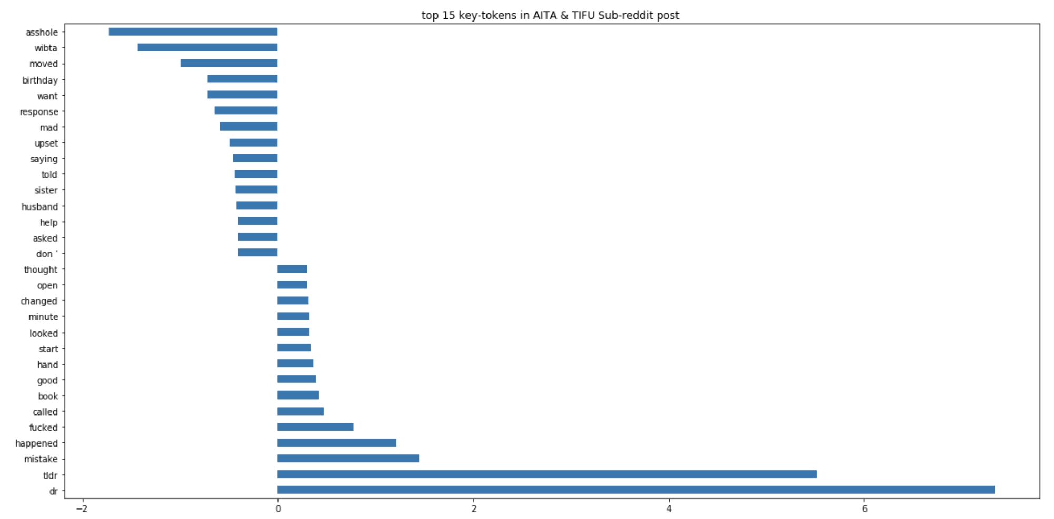
Initial Hypothesis & Findings
A.I.T.A
T.I.F.U

Slide 11
Conclusion & Recommendations
Current Model is xxx % Accurate
The model works in classifying certain key-words to the respective sub-reddit post
This model can be further modified with more Subreddits to recommend different Subreddits with similar topics for users to look at and choose from.

